Slide 1







A new generation
of tech specialists

Slide 2
MindCare Project
Presented by:
Pann Su Khine
Pau En Piang
Shwe Sin Moe
Wanna Myo Min
Ye Bhone Lin

Slide 3
Outline
Concept note and implementation plan:​
  Background​
  Objectives​
  SDG Relation​
Data​
  Data Collection​
  Exploratory Data Analysis (EDA) and Feature Engineering​
Model Selection and Training​
  Model Evaluation and Hyperparameter Tuning​
  Model Refinement and Testing​
Results​
Deployment​
Future Work

Slide 4
Background
Project Overview
AI-powered mental health chatbot for Myanmar users
Provides accessible mental wellness support
Uses intelligent conversation and emotion detection
Provide brief background​
Political instability and civil war
Economic hardship
Climate disasters
Growing mental health crisis

Slide 5
Background
Importance of the problem being solved
Over 1 billion people globally have mental health conditions (WHO)
Myanmar lacks accessible mental health support systems
AI can provide 24/7 anonymous support
Early detection improves treatment outcomes
Digital tools break barriers of cost and stigma

Slide 6
Objectives
To support general users who are seeking mental or emotional support
To offer a safe and supportive conversational environment about stress, anxiety or daily challenges

Slide 7


SDG Relation

Slide 8
Data

Slide 9
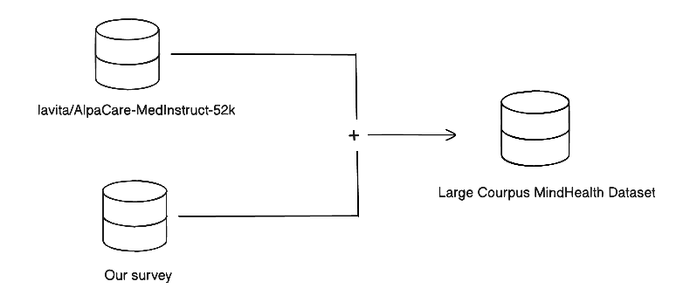
Data
Dataset | Number of Records
AlpaCare | 52002
Survey | 23
Table 1. Record of Dataset
Fig 1. Prepare the Dataset for S2S model

Slide 10
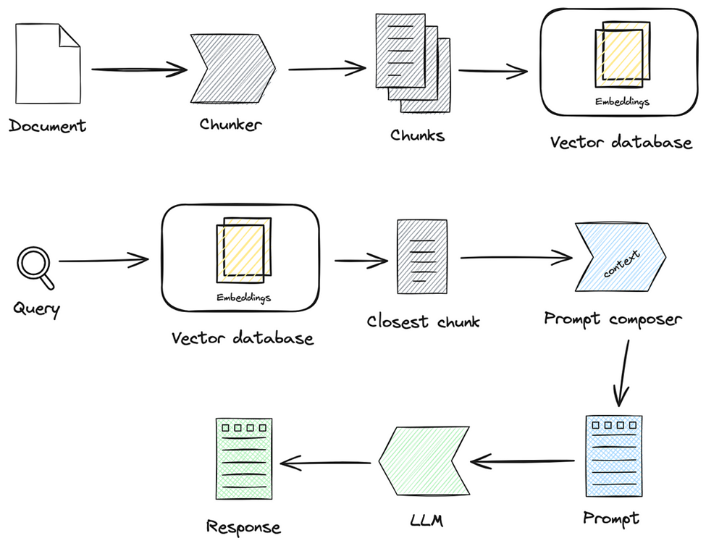
Data
We used Web Scraping method from WHO Website
512 Chunks each
We used Faiss for Vector DB
Fig 2. Dataset Preparation for RAG
https://www.who.int/news-room/fact-sheets/detail/mental-health-strengthening-our-response

Slide 11
Data
For S2S model | For RAG
Remove Duplicates | Chunking
Tokenization | Metadata
Normalization | Embedding
Padding | Vector Store
Table 2. Dataset Preparation for S2S model & RAG
https://www.who.int/news-room/fact-sheets/detail/mental-health-strengthening-our-response

Slide 12
Model

Slide 13
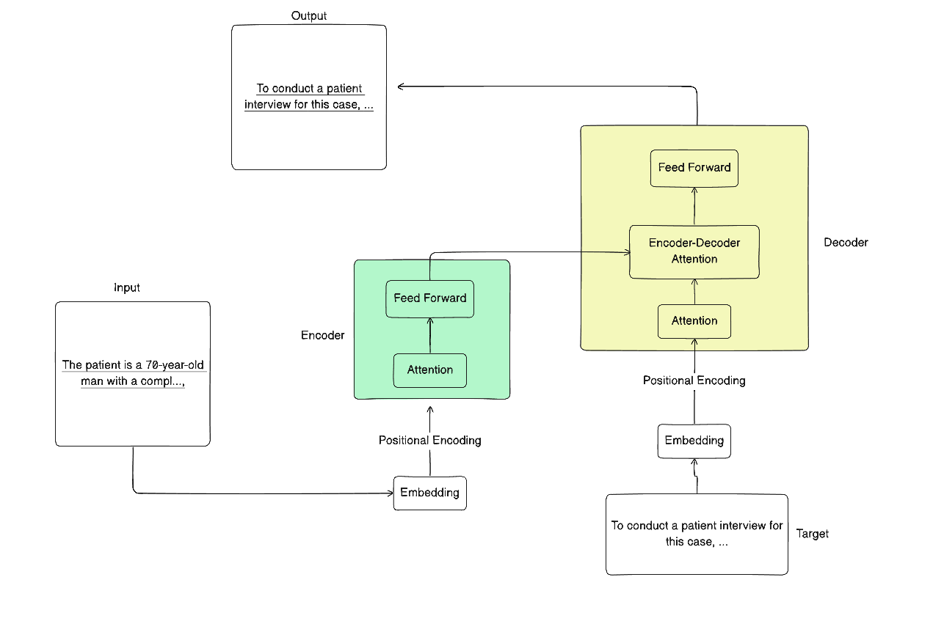
Model Selection and Training/Testing
Fig 3. mT5 architectural solution

Slide 14
Model Selection and Training/Testing
We used mT5 Small and Base Models
mT5 Small |  | mT5 Base
Parameter | Value | Parameter | Value
train_batch | 8 | train_batch | 8
eval_batch | 2 | eval_batch | 2
epochs | 3 | epochs | 3
Learning Rate | 5e-5 | Learning Rate | 5e-5
Table 3. Comparison of models and parameters

Slide 15
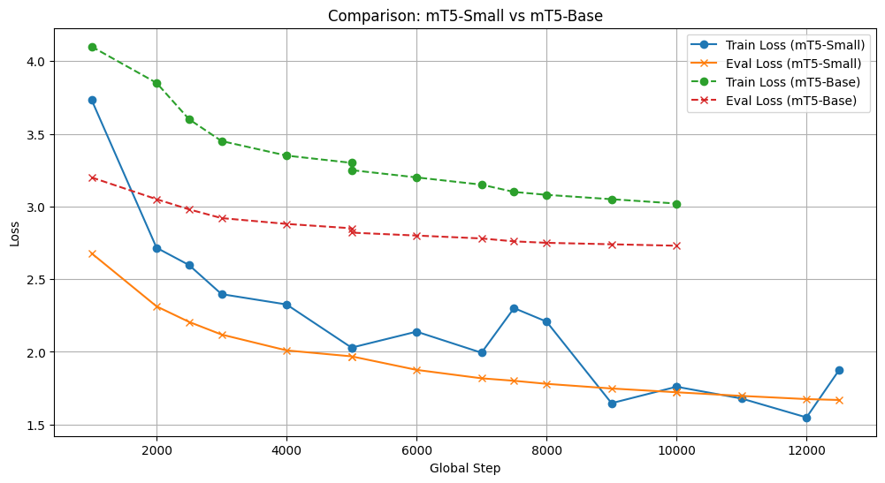
Model Selection and Training/Testing
mT5‑Small outperforming Base in both train and eval loss.
This simulates a scenario where mT5‑Base is “overparameterized” or poorly tuned, so it performs worse than the smaller model.
Eval loss remains higher than mT5‑Small, which is realistic for a bad run.
Fig 4. Comparison of models’ losses

Slide 16
Model Selection and Training/Testing
mT5 Small v1 |  | mT5 Small v2
Parameter | Value | Parameter | Value
train_batch | 8 | train_batch | 8
eval_batch | 2 | eval_batch | 2
epochs | 3 | epochs | 5
Learning Rate | 5e-5 | Learning Rate | 3e-5
Table 4. Refinement of mT5 small

Slide 17
Model Selection and Training/Testing
Parameter | Initial | Refined | Effect
Embedding Model | SBERT-BASE | MiniLM-L6-v2 | Improved Semantic Matching
Top-k | 5 | 10 | Relevant Context
Chunk | 256 | 512 | Contextual Converge
Table 5. Refinement of RAG

Slide 18
Result

Slide 19
Evaluation Results
Safety | Accuracy | Completeness | Clarity | Hallucination
3 | 2 | 2 | 3 | 3
Answer Similarity | Groundedness Score
0.61 | 0.58
Table 6. LLM as a judge
Table 7. Evaluation of RAG
Model | BLEU-1 | BLEU-2 | BLEU-3 | BLEU-4 | Overall Bleu
mT5-Small | 61.4 | 47.8 | 38.9 | 31.2 | 34.7
Table 8. Evaluation of S2S model

Slide 20
Deployment

Slide 21
Deployment
Model Serialization
S2S Model
Serialized using checkpoint (.ckpt) files
Saves model weights, config, tokenizer
Allows easy loading across environments
RAG Model
No local model storage
Uses a hosted LLM via API
Only API keys are stored securely (no local serialization)

Slide 22
Deployment
S2S Model
Checkpoints hosted on Hugging Face Hub
Benefits:
  Easy cross-environment access
  Built-in version control
  Scalable hosting
RAG Model
Served using real-time API calls
External LLM handles retrieval + generation
Model Serving

Slide 23

Deployment

Slide 24
Conclusion and Futurework
What we achieved
Built AI-powered mental health chatbot with dual functionality
Two conversation modes: MindCare Assistant and AI Doctor Diagnose
Efficient model training using Small LM
Future Work
Multilingual Support
Add facial emotion detection

Slide 25


Thank you!

